Slide 1
Poetry of WWII SEction 5
Zhulie wahidi Lily millar
Josh Hernandez Dallin silcox

Slide 2
What does vergissmeinicht mean?
Forget Me Not

Slide 3
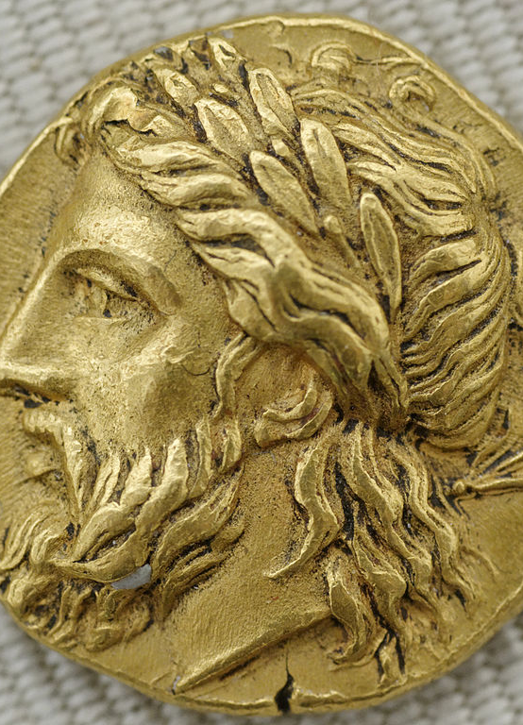
" Lay the coin on my tongue and I will sing of what the others never set eyes on."​
What are these lines of the poem an allusion to?​
Greek habit of laying coin on tongue of the dead in payment to Acheron

Slide 4
A war poem beginning with the word living creates .
Ironic tone

Slide 5
What does the writer of this poem realize when he writes: ​ " I look each side of the door of sleep"
Death and sleep are similar; sleep is a temporary death

Slide 6
In vergissmeinicht, The image of a handwritten love note found on a corpse creates an image of what? ,
Spoiled love

Slide 7
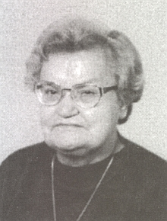
In VergIssmeinicht, who is steffi?
His girlfriend

Slide 8
The word vergissmeinicht has what two Meanings in the poem?
1. For a man to not forget his lover
2. To create the idea that love is like a delicate flower

Slide 9
In line 4 of war poet it goes an arrow in my ___________
Hand

Slide 10
In the poem war poet it goes I am the builder whose firm walls_____
Surround

Slide 11
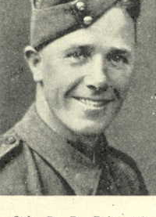
What branch of military did donald bain serve in
Royal Artillery

