Slide 1
Art Section IV
Super quiz questions

Slide 2
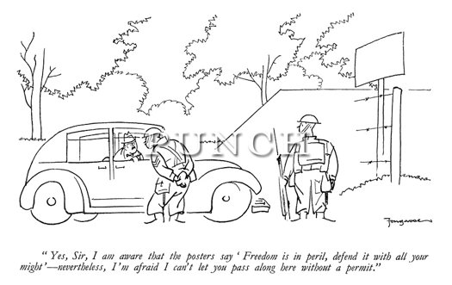
Question One
What is Fougasse's belief for a successful cartoon?
Answer: Fougasse believed that a sense of humor is more important than a sophisticated drawing when it comes to a cartoon

Slide 3
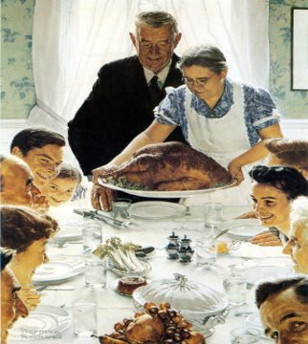
Question Two
What were the names of Rockwell's freedom paintings and how many were there?
Answer: 4 Freedom Paintings- Freedom from Want; Freedom of Worship; Freedom from Fear; Freedom of Speech

Slide 4
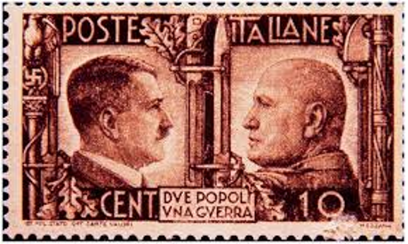
Question Three
Who are the two leaders depicted on the Ten Lire postage?
Answer: Musolini and Hitler.

Slide 5
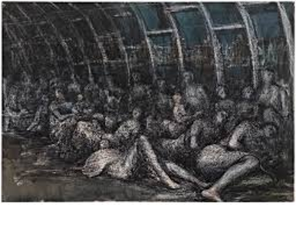
Question Four
Who drew the Shelter drawings?
Answer: Henry Moore

Slide 6
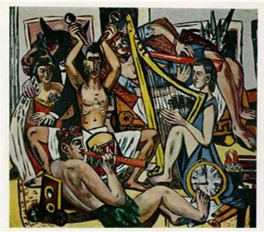
Question Five
Blind Man's Buff
Blind Man's Buff refers to air raids, lack of ___, coal and ____.
Answer: food coal and electricity

Slide 7
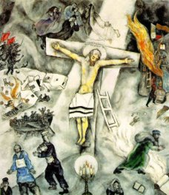
Question Six
1944-1945
White Crucifixion
Beckmann started painting Blind Man's Buff in ___ and finished in ____.

Slide 8
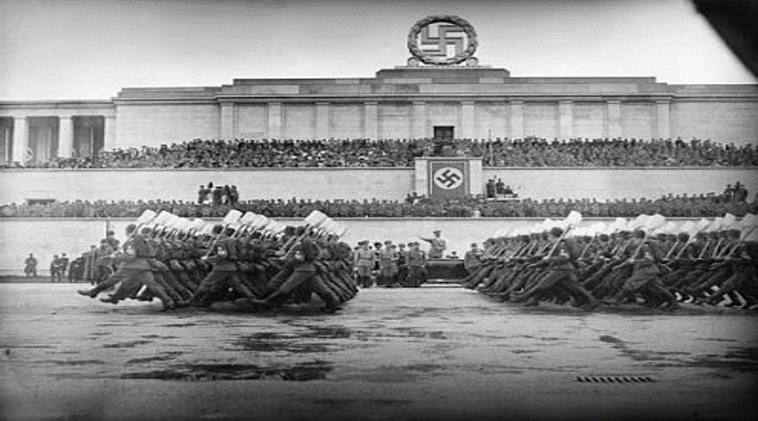
Question Seven
How many years was Speer Hitler's chief architect?
Answer: 12 years (1933-1945)

Slide 9

Question Eight
What year was Zepplinfeld
Made?
Answer: 1936

Slide 10
Question Nine
White Crucifixion refers to the sufferings of what?
Answer: Jesus and the Jewish

Slide 11
Question Ten
"Yes, sir I am aware that the poster says ______ is ______ defend with all your might- nevertheless, I'm afraid I cant let you pass along here without a ________."
"Yes, sir I am aware that the poster says freedom is peril defend with all your might- nevertheless, I'm afraid I cant let you pass along here without a permit."

